Slide 1
Algorithms: Greedy Method
Shortest Path Problems

Slide 2
Shortest-Path
Given a graph (directed or undirected) G = (V, E) with weight function w: E → R and a vertex s∈V, find for all vertices v∈V the minimum possible weight for path from s to v.
The weight of path p = v₁ → v₂ → … → v_{k} is
Shortest path = a path of the minimum weight
Algorithm will compute a shortest-path tree.

Slide 3
Shortest-Path Problems
Shortest-Path problems
Single-Source (Single-Destination): Find a shortest path from a given source (vertex s) to each of the vertices.
Single-Pair: Given two vertices, find a shortest path between them. Solution to single-source problem solves this problem efficiently, too.
All-Pairs: Find shortest-paths for every pair of vertices. Dynamic programming algorithm.

Slide 4
Single-Source Shortest Path
Given a graph (directed or undirected) G = (V, E) with weight function w: E → R and a vertex s∈V, find for all vertices v∈V the minimum possible weight for path from s to v.
We will discuss two general case algorithms:
Dijkstra's Algorithm (positive edge weights only)
Bellman-Ford Algorithm (positive and negative edge weights)
If all edge weights are equal (let's say 1), the problem is solved by BFS in Θ(V + E) time.

Slide 5
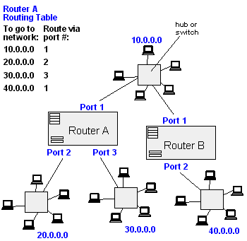
Single-Source Shortest Path
Traffic Information Systems are most prominent use
Mapping (Map Quest, Google Maps)
Routing Systems

Slide 6
Shortest Path Properties
The shortest path problem satisfies the optimal substructure property:
Subpaths of shortest paths are shortest paths.
Proof: suppose some subpath P₁ is not a shortest path
There must then exist a shorter subpath P₂
Could substitute the subpath P₁ by the shorter path P₂
But then overall path is not the shortest path. Contradiction
P₁
P₂

Slide 8
Shortest Path Properties
Define δ(u, v) to be the weight of the shortest path from u to v
Shortest paths satisfy the triangle inequality: δ(u, v) ≤ δ(u, x) + δ(x, v)
Proof :
x
u
v
This path is no longer than any other path

Slide 9
Shortest Path Properties
In graphs with negative weight cycles, some shortest paths will not exist ( Why ? ):
< 0

Slide 10
Relaxation
A key technique in shortest path algorithms is relaxation
Idea: for all v, maintain upper bound d[v] on δ(s, v)
Relax(u,v,w) {
if (d[v] > d[u]+w(u,v))
then d[v] = d[u]+w(u,v);
p[v] = u;
}
u
v
u
v
2
2
5
9
5
6
Relax(u,v)
Relax(u,v)
5
7
5
6
2
2
u
v
u
v

Slide 11
Bellman-Ford Algorithm
BellmanFord()
for each v ∈ V
d[v] = ∞;
d[s] = 0;
for i=1 to |V|-1
for each edge (u,v) ∈ E
Relax(u,v,w);
for each edge (u,v) ∈ E
if (d[v] > d[u] + w(u,v))
return “no solution”;
Relax(u,v,w): if (d[v] > d[u]+w(u,v))
then d[v]=d[u]+w(u,v)
p[v]=u
Initialize d[], which
will converge to shortest-path value δ
Relaxation: Make |V|-1 passes,
relaxing each edge
Test for solution Under what condition
do we get a solution?

Slide 12
Bellman-Ford Algorithm
BellmanFord()
1 for each v ∈ V
2 d[v] = ∞;
3 d[s] = 0;
4 for i=1 to |V|-1
5 for each edge (u,v) ∈ E
6 Relax(u,v,w);
7 for each edge (u,v) ∈ E
8 if (d[v] > d[u] + w(u,v))
9 return “no solution”;
Relax(u,v,w): if (d[v] > d[u]+w(u,v))
then d[v]=d[u]+w(u,v)
Q: What will be the
running time?
A: O(V E )

Slide 13
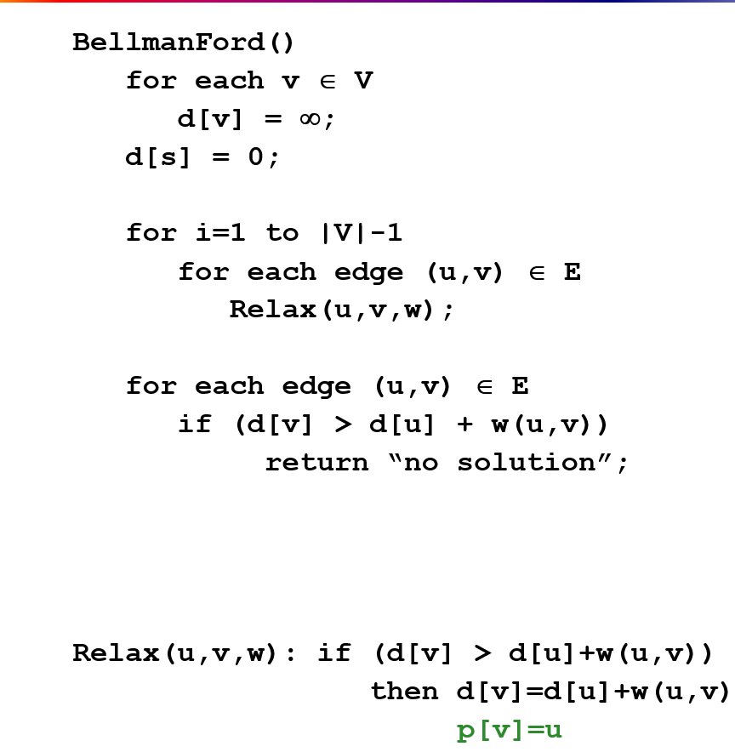
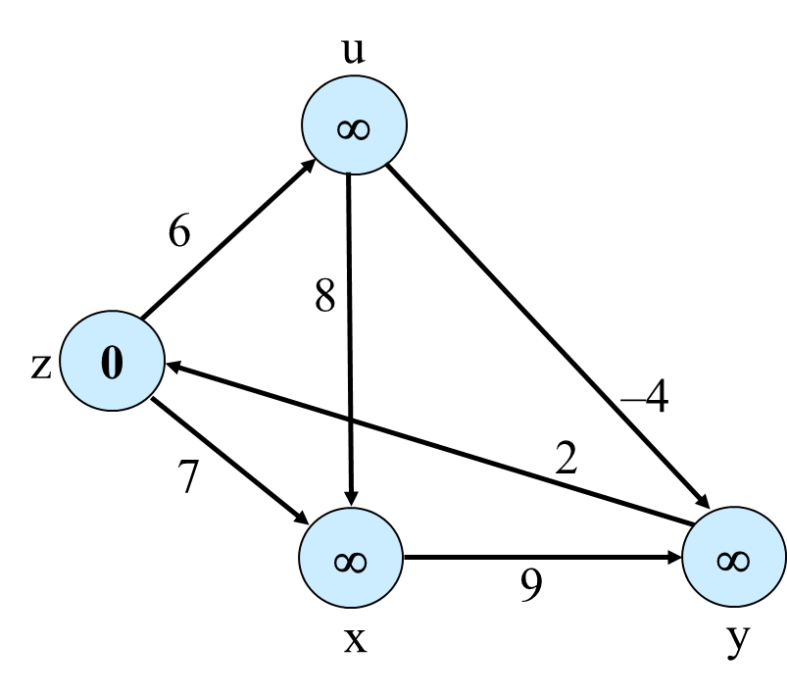
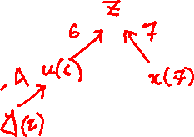
Bellman-Ford Algorithm: Example 0
assume z is source,
the order of edges are:
ux, uy, zu, zx, xy, yz
loop1:
ux: inf > inf+8
uy: inf >inf+(-4)
zu: inf > 0+6: yes
zx: inf > 0+7: yes
xy: inf > 7+9: yes
yz: 0 > 14 + 2
 | z is src | u | v | x | y
loop | 0 | inf | inf | inf | inf
1 |  | 6, z |  | 7, z | 14, x
2 |  |  |  |  | 2, u
3
loop2:
ux: 7>6+8
uy: 14>6+(-4):yes
zu: 6>0+6
zx: 7>0+7
xy: 2>7+9
yz: 0>2+2
loop3
ux: 7>6+8
uy: 2>6+(-4)
zu: 6>0+6
zx: 7>0+7
xy: 2>7+9
yz: 0>2+2

Slide 14
Bellman-Ford Algorithm: Example
u
v
5
∞
∞
–2
6
–3
8
z
0
7
–4
7
2
∞
∞
9
x
y

Slide 15
Bellman-Ford Algorithm: Example
u
v
5
6
∞
–2
6
–3
8
z
0
7
–4
7
2
7
∞
9
x
y

Slide 16
Bellman-Ford Algorithm: Example
u
v
5
6
4
–2
6
–3
8
z
0
7
–4
7
2
7
2
9
x
y

Slide 17
Bellman-Ford Algorithm: Example
u
v
5
2
4
–2
6
–3
8
z
0
7
–4
7
2
7
2
9
x
y

Slide 18
Bellman-Ford Algorithm: Example
u
v
5
2
4
–2
6
–3
8
z
0
7
–4
7
2
7
-2
9
x
y

Slide 19
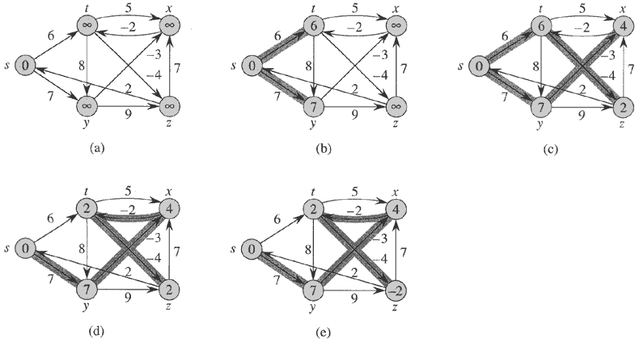
Bellman-Ford Algorithm: Example

Slide 20
Simulation
https://www-m9.ma.tum.de/graph-algorithms/spp-bellman-ford/index_en.html

Slide 21
Shortest Path Tree

Slide 22
Dijkstra’s Algorithm
If no negative edge weights, we can beat Bellman-Ford Algorithm
Similar to breadth-first search
Grow a tree gradually, advancing from vertices taken from a queue
Also similar to Prim’s algorithm for MST
Use a priority queue keyed on d[v]

Slide 23
Dijkstra’s Algorithm
Dijkstra(G)
for each v ∈ V
d[v] = ∞;
d[s] = 0; S = ∅; Q = V;
while (Q ≠ ∅)
u = ExtractMin(Q);
S = S U {u};
for each v ∈ u->Adj[]
if (d[v] > d[u]+w(u,v))
d[v] = d[u]+w(u,v);
p[v] = u;
Relaxation Step
Note: this is really a call to Q->DecreaseKey()

Slide 24
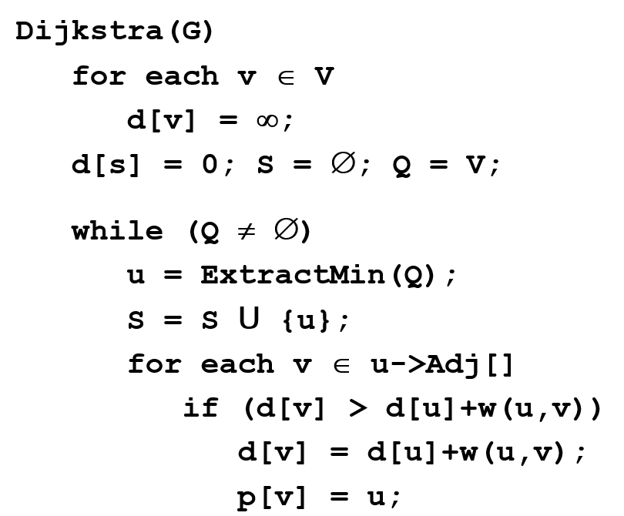
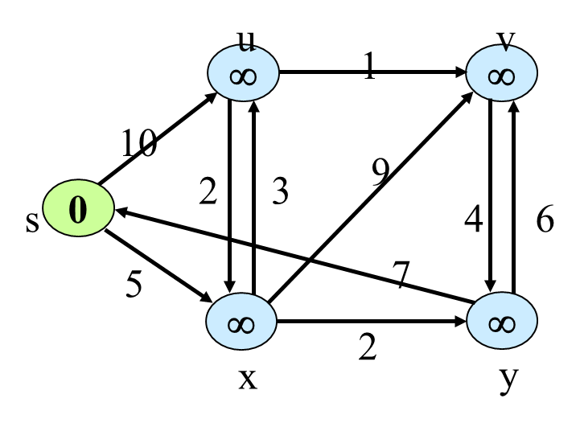
S={s,x,y,u,v }
 | s | u | v | x | y
 | 0 | inf | inf | inf | inf
s (0) |  | 10,s |  | 5,s
x(5,s) |  | 8,x | 14,x |  | 7,x
y(7,x) |  |  | 13,y
u(8,x) |  |  | 9,u
v(9,u)

Slide 25
Dijkstra’s Algorithm
u
v
Dijkstra(G)
for each v ∈ V
dist[v] = ∞;
parent[v] = NIL;
dist[s] = 0; S = ∅; Q = V;
while (Q ≠ ∅)
u = ExtractMin(Q);
S = S U {u};
for each v ∈ u->Adj[]
if (dist[v] > dist[u]+w(u,v))
dist[v] = dist[u]+w(u,v);
parent[v] = u;
∞
1
∞
10
9
2
3
s
0
4
6
5
7
∞
∞
2
x
y

Slide 26
Dijkstra’s Algorithm: Example
u
v
∞
1
∞
10
9
2
3
s
0
4
6
5
7
∞
∞
2
x
y

Slide 27
Dijkstra’s Algorithm: Example
u
v
10
1
∞
10
9
2
3
s
0
4
6
5
7
5
∞
2
x
y

Slide 28
Dijkstra’s Algorithm: Example
u
v
8
1
14
10
9
2
3
s
0
4
6
5
7
5
7
2
x
y

Slide 29
Dijkstra’s Algorithm: Example
u
v
8
1
13
10
9
2
3
s
0
4
6
5
7
5
7
2
x
y

Slide 30
Dijkstra’s Algorithm: Example
u
v
8
1
9
10
9
2
3
s
0
4
6
5
7
5
7
2
x
y

Slide 31
Dijkstra’s Algorithm: Example
u
v
8
1
9
10
9
2
3
s
0
4
6
5
7
5
7
2
x
y

Slide 32
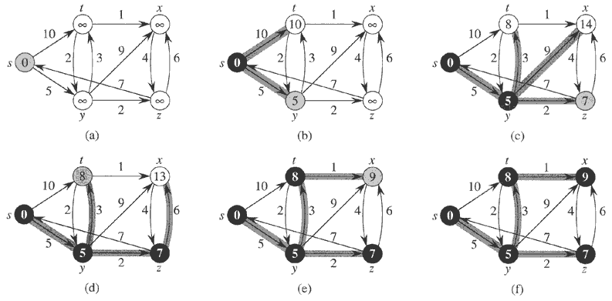
Dijkstra’s Algorithm: Example

Slide 33
Dijkstra’s Algorithm
Dijkstra(G)
for each v ∈ V
d[v] = ∞;
d[s] = 0; S = ∅; Q = V;
while (Q ≠ ∅)
u = ExtractMin(Q);
S = S U {u};
for each v ∈ u->Adj[]
if (d[v] > d[u]+w(u,v))
d[v] = d[u]+w(u,v);
How many times is ExtractMin() called?
How many times is DecraseKey() called?
What will be the total running time?

Slide 34
Dijkstra’s Algorithm
Dijkstra(G)
for each v ∈ V
d[v] = ∞;
d[s] = 0; S = ∅; Q = V;
while (Q ≠ ∅)
u = ExtractMin(Q);
S = S U {u};
for each v ∈ u->Adj[]
if (d[v] > d[u]+w(u,v))
d[v] = d[u]+w(u,v);
A: O(E lg V) using binary heap for Q
Can achieve O(V lg V + E) with Fibonacci heaps

Slide 35
Dijkstra’s Algorithm
Dijkstra(G)
for each v ∈ V
d[v] = ∞;
d[s] = 0; S = ∅; Q = V;
while (Q ≠ ∅)
u = ExtractMin(Q);
S = S U {u};
for each v ∈ u->Adj[]
if (d[v] > d[u]+w(u,v))
d[v] = d[u]+w(u,v);
Correctness: we must show that when u is removed from Q, it has already converged

Slide 36
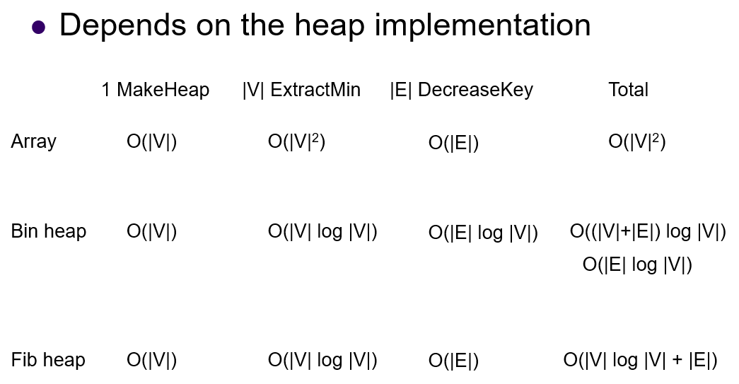
Runtime

Slide 37
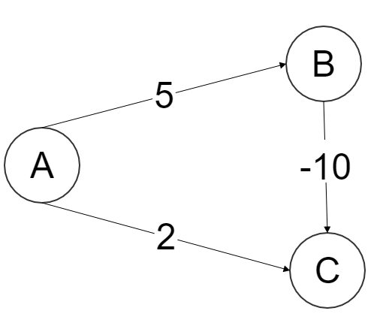
Why doesn't Dijkstra's algorithm work for negative weight edges?
Dijkstra from A will first develop C, and will later fail to find A->B->C

Slide 38
Can we use Dijkstra's algorithm with negative weights?
Increasing all the weights by a constant value so that they are non-negative will not work. To see this, consider the graph where there are two paths from A to B, one traversing a single edge of length 2, and one traversing edges of length 1, 1, and -2. The second path is shorter, but if you increase all edge weights by 2, the first path now has length 4, and the second path has length 6, reversing the shortest paths. This tactic will only work if all possible paths between the two points use the same number of edges.

Slide 39
Pattern
Write SP algo for a graph with positive and negative edge weights.
Analyze the running time (array, priority queue)
Find the longest shortest path
Example of how BF detects negative weight cycle.
a – b –c –d –e –f –g – c – d can it be the shortest path for a graph?
Scenario

